Slide 1
Platform Modernization

Slide 2
Agenda
Objectives
Current Inventory
Deprecated Process & Component List
Process Change
Approaches
Proposed Design

Slide 3
Objective
Unified modeling for desktop and device applications
Platform to manage enterprise product development life cycle management
Ramco Developer Studio - Integrated modeling platform comprising solutioning, engineering and code generation functions
Efficient Business Process and Event Modeling
Technology agnostic - Product specification as data
Impact of changes can be ‘measured’
Rule specifications to support user element state properties
Version control is central and inherent – Facilities Devops process for managing assets

Slide 4
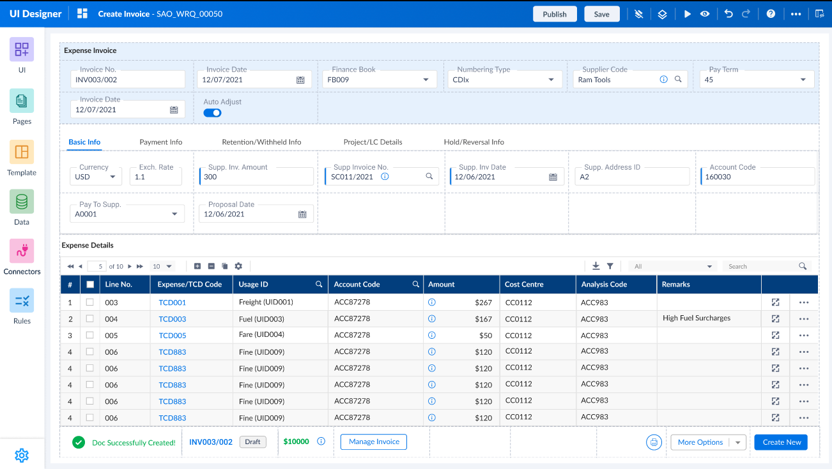
UI designer capabilities
Facilitates user interface design for Base Platform, iEDK and Enterprise Personalization
Support for both Sencha and Nebula UI frameworks
Capable of handling table layouts as well as responsive and adaptive design
Drag & Drop visual user interface designer – Proto and live preview option with sample data
Enforces standards across the user interface manifestation & behavior
Embedded card designer for designing composite control

Slide 5
Engineering capabilities
Support for multiple data adapters
WCF services
Stored Procedures
Bulk Insert
Custom BRO
Elasticsearch
REST Apis
UDS – GraphQL
Offline queries

Slide 6
Engineering capabilities
Support for Universal Personalization Engine (UPE) and Solr
Provision for report modeling
Capability to launch VwApie and GraphQL studio with data context (embedded within platform container)
Inline specifications for callouts - Pre-Validations and Post Operations to the existing business logic across all layers

Slide 7
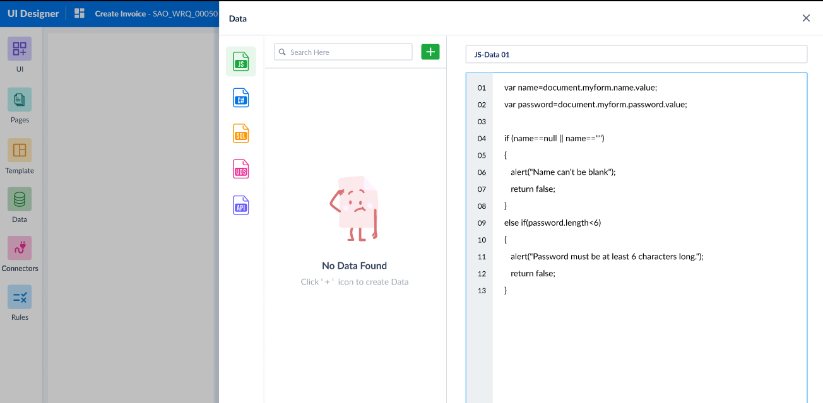
Ramco Developer Studio – Callout Specifications

Slide 8
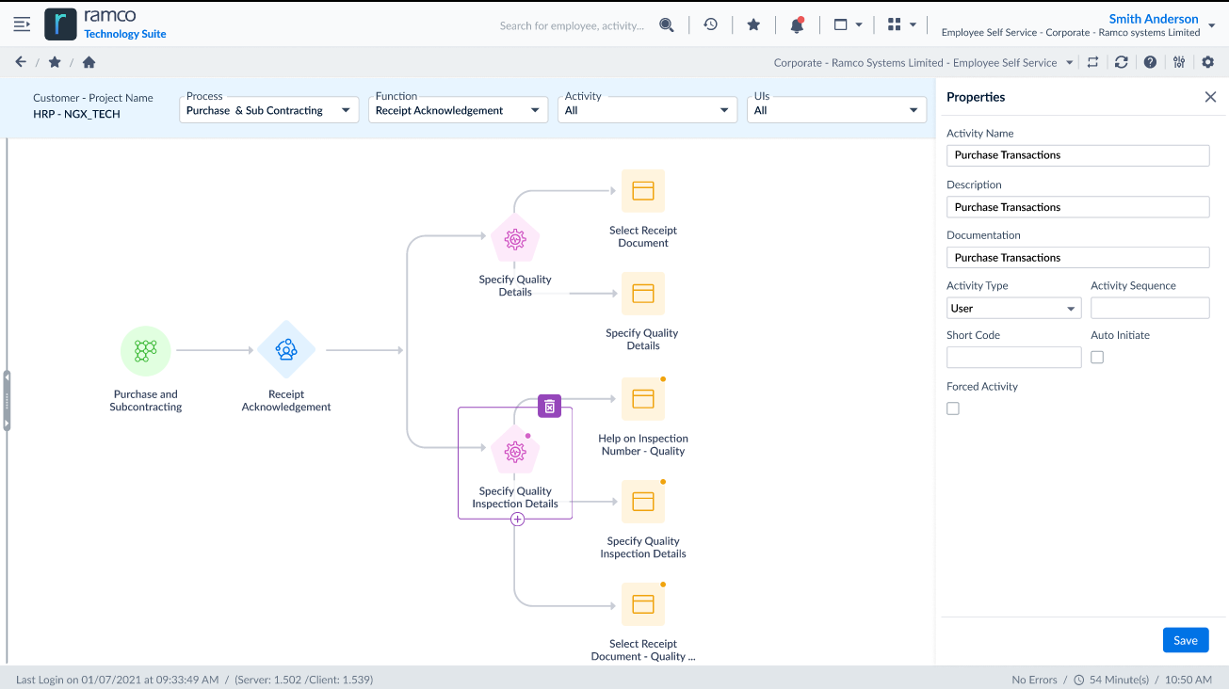
Ramco Developer Studio – BPM Specifications

Slide 9
TECH Stack
Grape JS / tool jet??
React
Typescript
SCSS
Node Server / IIS

Slide 10
Inventory of code generators relying on current schema
Client Layer Generators
Desktop - Hub JSON Generator
Desktop – Glance JSON Generator
Mobility
mHub
Unify
Evolv
Native Apps
.Net Code Generators
State xml generator
Web layer - activity dll
App layer - Service Dlls
App layer – Error dlls
UPE Script generators
MDCF excel generators
Report script generator
Report ASPX generator
J2EE Code Generators
Web layer - activity bean
App layer - Service beans
App layer – Resource files
Other
UI meta generators for test scripts
Deployment script generator
Workflow script generator

Slide 11
Approach 1 : Continue with current schema
Pros
Cons
Interoperability for current work bench and modern platform
No major impact for existing generator feeds
Monolithic – Approx 3000+ table – 3 database (base, publish and handle changes db).
Model size growth in TB
Normalization missing in many tables (duplicate data across table, missing foreign keys, etc)
Exception data – clean-up??
String manipulation in backend for code generation feed xml - unstructured xml – performance issues reported frequently
BT Synonym – Referred as key attributes for all UI element definitions (page, section, control, column, etc)

Slide 12
Approach 2 : New schema
Pros
Cons
Schema can be refactored as required
Possibility to move to different data source (GIT, POSTGRES)
BT Synonym can be captured only for required entities
Interoperability not feasible
Migration activity requires additional effort and manpower. Will require SBU involvement for validation and verification

Slide 13
Process Change
RCN to be merged with WR
Handle changes DB??

Slide 14
Deprecated process & components
Planning and Control
Estimation
High Level Planning
Detailed Planning
Time Booking
Prepare Deliverables
Handle Requirements
Documentation
Application Layer Validation
Client Layer Validation
Review Management
Request Consolidation
Software Subcontracting
10. Development Test Planning
Development Test Execution
Construction Engineering??

Slide 15
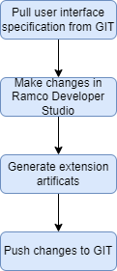
Extension - Process flow

Slide 16
Proposed Delivery Plan

Slide 17
Discussion Points
Workflow component in platform model??
iRule definitions??
MDCF template specification and generation in platform model??
Custom Controls??
Scope of delivery for Extension – BPM, Engineering WCF Services??

